Slide 1

Casual Rider Vs Member Rider
Presented by : Siva koteswararao
Last updated : Sep-2023

Slide 2
Table of Contents
Casual Rider Vs Member Riders
Behaviour of Casual and member Riders , Booking pattern.
Total booking, Week wise books, Bike usage, Repeated visited locations.
Based on pattern and insight to Casual Riders Are mostly Weekends visit leisure place and hotels, Restaurants

Slide 3
Objective
Identifying different usage between the casual and members riders, Booking, Bike selections, Week wise booking , Repeated visits location, insight of data

Slide 4
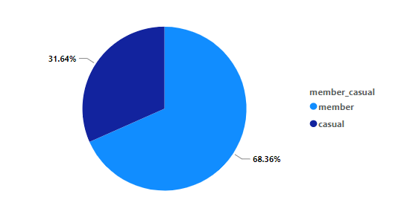
Total Ride Booking
Key_Takeaway :
Total rides booked by Mar-2022 both Casual & Member
Member are most booking with 68.36%
Next Casual rider booking with 31.64%

Slide 5
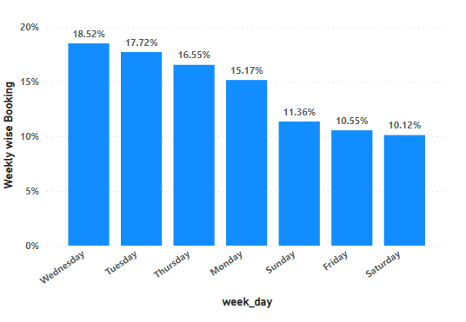
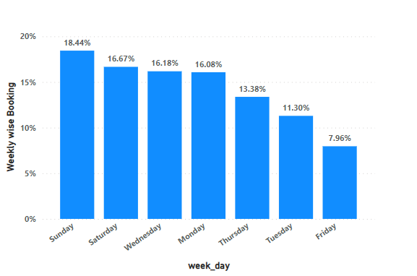
Week wise booking
Member Riders
Casual Riders
Key_Takeaway :
Key_Takeaway :
Member Riders was mostly booked ride on weekdays like Wednesday, Tuesday, Thursday, Monday.
Casual Riders was mostly booked ride on weekends like Sunday, Saturday, and also Wednesday

Slide 6
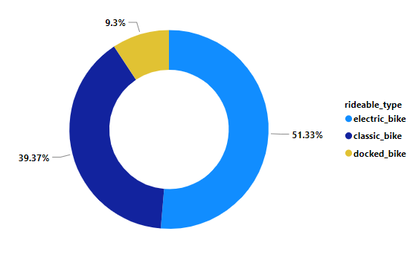
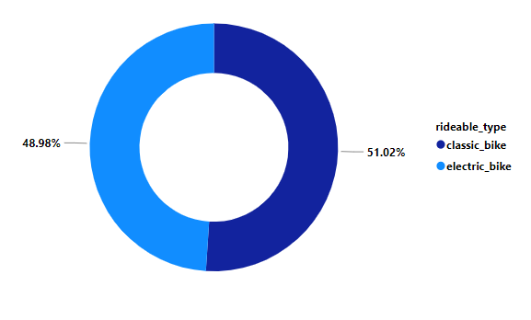
Ride Bike Usage
Casual Riders
Member Riders
Key_Takeaway :
Key_Takeaway :
Member Riders was mostly booked ride on weekdays like Wednesday, Tuesday, Thursday, Monday.
Member Riders was mostly booked ride on weekdays like Wednesday, Tuesday, Thursday, Monday.

Slide 7
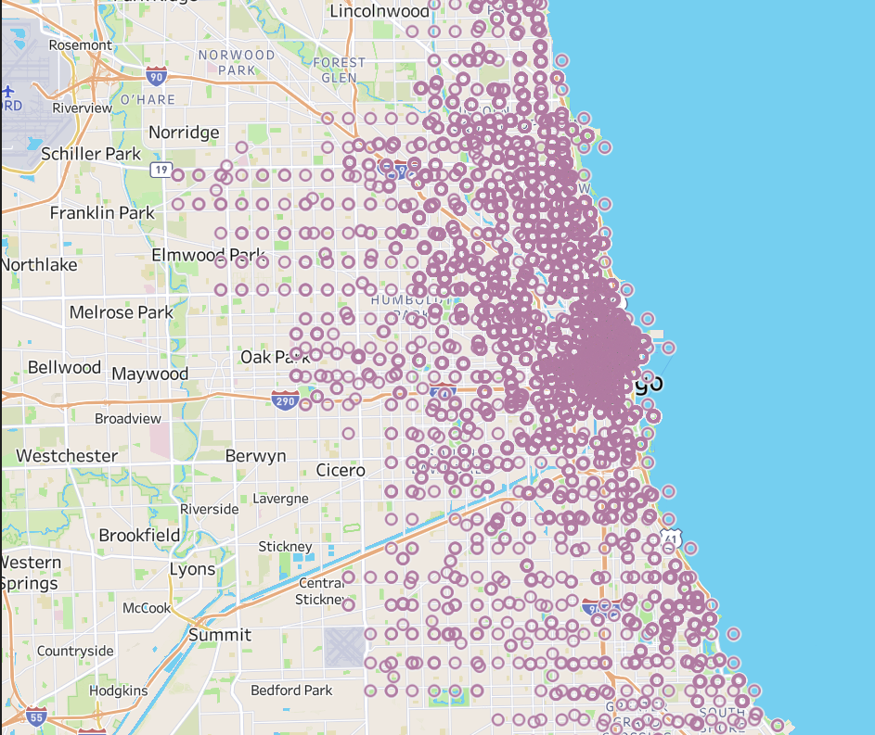
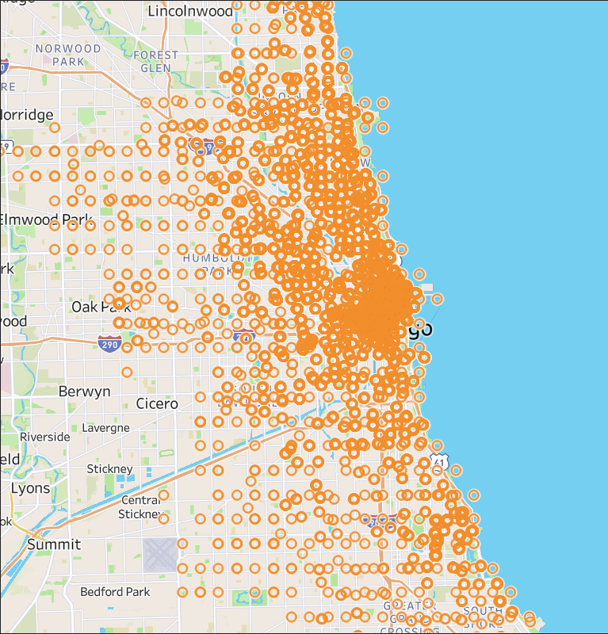
Repeated visited Location
Casual Riders
Member Riders
Key_Takeaway :
Key_Takeaway :
Member Riders was mostly booking for University, Offices, visit to Local Parks.
Casual Riders was mostly booking for Hotels, Restaurants, Parks, Beaches (Some Tourist Place)

Slide 8
Conclusion
Member was use cyclisting bikes for university and Work places, They mostly Student & Local Working Professionals.
They preferred to use Electric & classic Bike only.
Casual riders was use cyclisting bike for Hotels, tourist place, Restaurant, Beaches
They preferred to use Electric & classic rarely used Docked bikes

Slide 9
Recommendation
I would suggest that in order to convert the casual to the Membership users it would be interesting to focus the messages on the Tourist Place aspect of the service, and maybe offer some kind of promotion related to weekends and/or electric bikes. And also provide Hotel & Food Coupes, Encourages Travelling.
Send Notification( Friday Night ) on Weekend to Suggest explores new leisure place. Some tourist place.

